Slide 1
Please install the rmarkdown package
install.packages("rmarkdown")
Download
“Module3_Lake_Ice_Phenology_Student.Rmd”
from Module 3

Slide 2
Model 3: Lake Ice Phenology
This module was initially developed as a Excel-based activity by Carey, C.C., J.L. Klug, and D.C. Richardson. 1 April 2015. Project EDDIE: Lake Ice Phenology. Project EDDIE Module 1, Version 1: http://cemast.illinoisstate.edu/data-for-students/modules/ice-phenology.shtml. Module development was supported by NSF DEB 1245707.

Slide 3
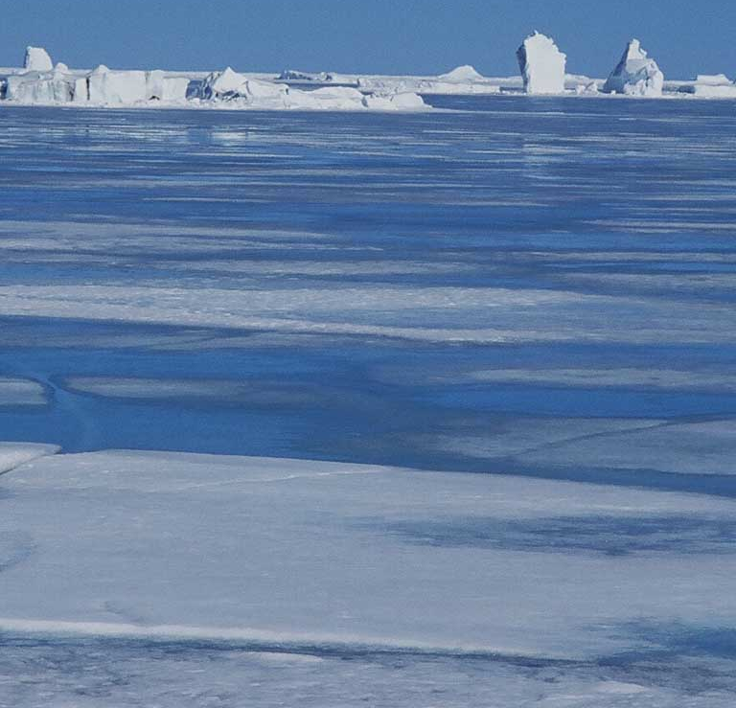
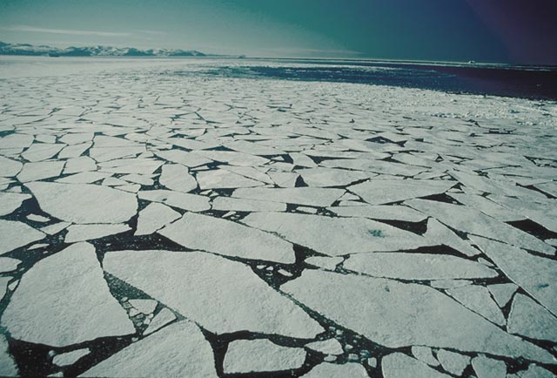
What is ice-off, anyway?

Slide 4
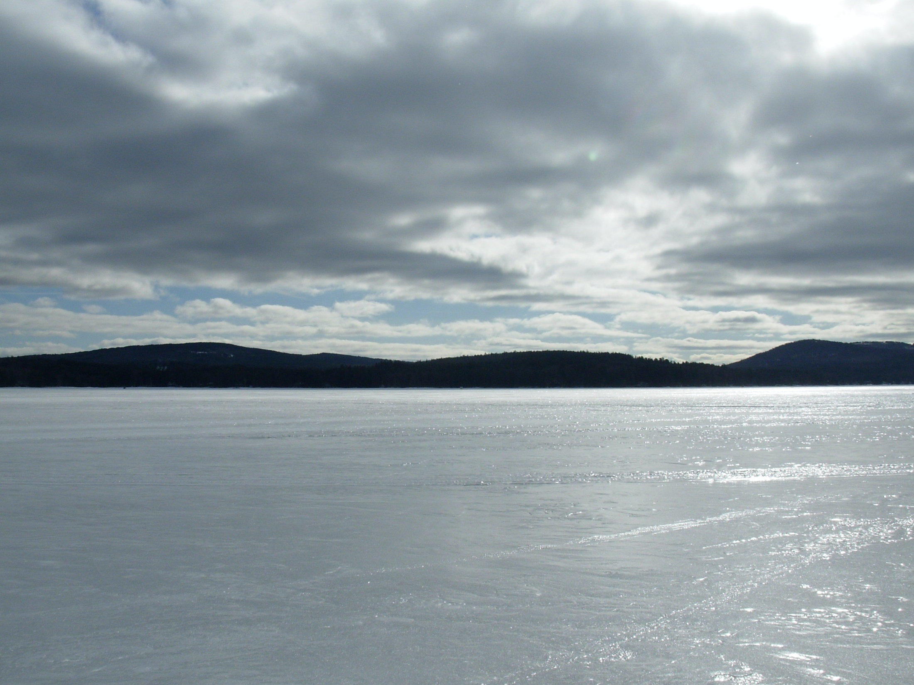
How does ice melt?

Slide 5
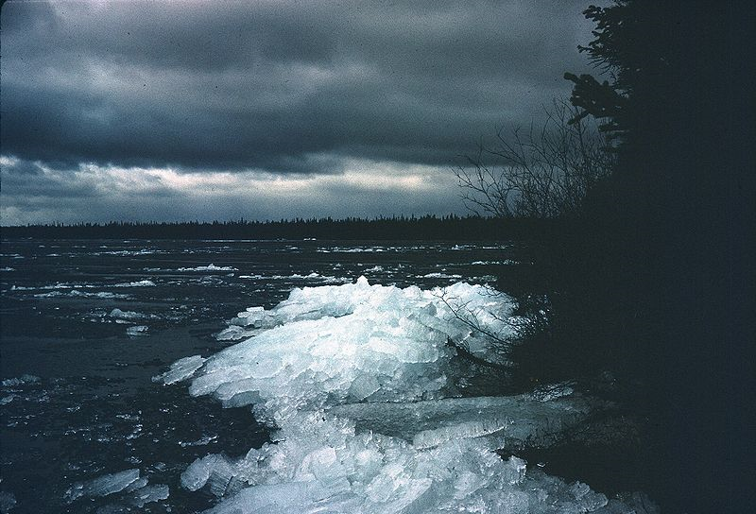
Ice candles

Slide 6
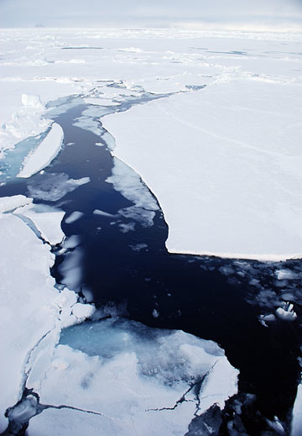
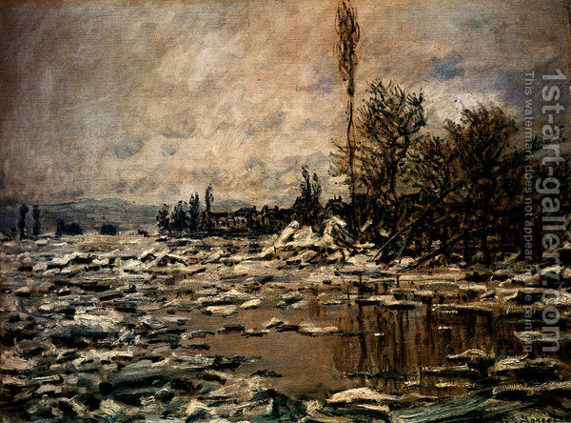
What was the proxy used for ice-out in Lake Constance in the Middle Ages?
Notes:
Monet painting!

Slide 7
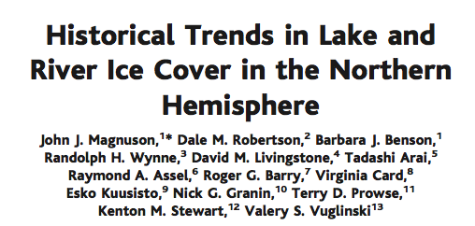
What was the proxy used for ice-out in Lake Constance in the Middle Ages?
Notes:
Monet painting!

Slide 8
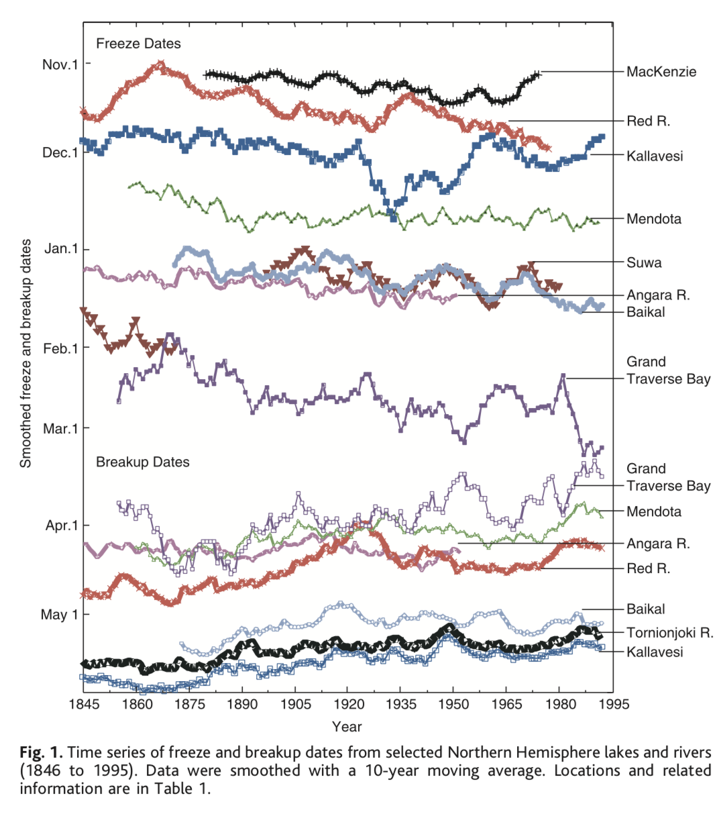
Magnuson et al. 2000 Science

Slide 9
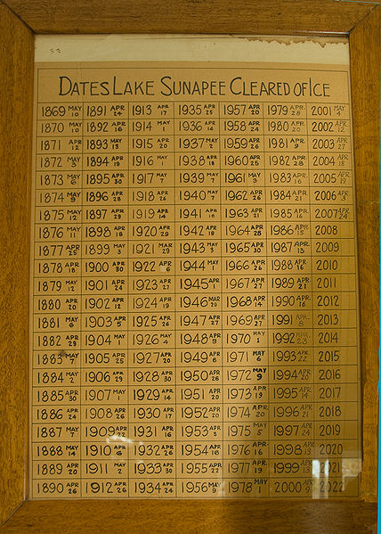
Sunapee dataset, and conversion to Julian days
Julian day: 01-Jan = 1
31-Dec = 365

Slide 10
Graphing Sunapee dataset

Slide 11
Linear regression overview
y = b + m*x
Independent variable:
Year (units=year)

Slide 12
Linear regression overview
y = b + m*x
Slope of line
(units=Julian days/Year)
‘-’ = getting earlier
‘+’ = getting later

Slide 13
Linear regression overview
y = b + m*x
Intercept
(units=year)
At x=0, what is y
Height of the line

Slide 14
Linear regression overview
y = b + m*x
Dependent variable
(units=julian day)
Day of ice-off

Slide 15
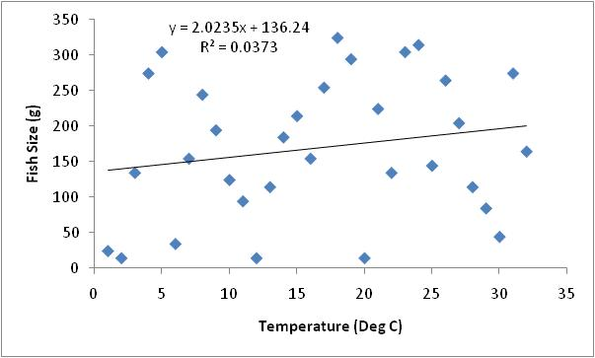
Linear regression overview
R²=proportion of variation explained
R² ~ 0
0% of variance explained

Slide 16
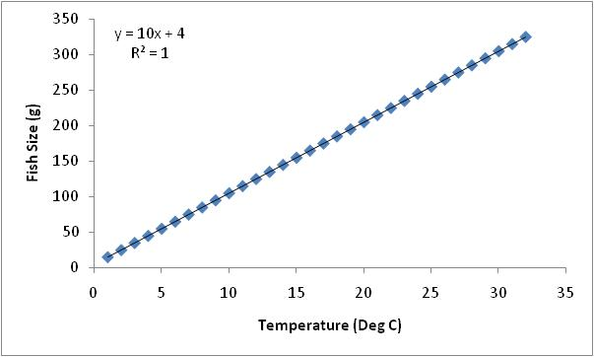
Linear regression overview
R²=proportion of variation explained
R²=1.00
100% of variance explained,
perfect line

Slide 17
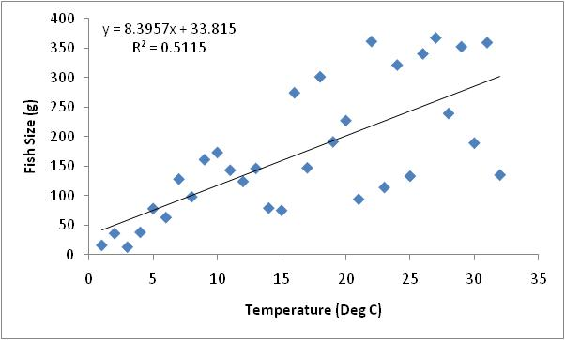
Linear regression overview
R²=proportion of variation explained
R²>0.3
30% of variance explained,
Good (enough) for ecology

Slide 18
Graphing Sunapee dataset
Multiple regression lines; look at slope, R² (indicator of variability)
Predict Ice-out for 2020

Slide 19
Lakes in data set
Lake Name | Location | Latitude | Lake area (km²) | Trophic status
Baikal | Siberia, Russia | 53 ºN | 31,722 | Oligotrophic
Cazenovia | Near Syracuse, NY, USA | 42 ºN | 4.5 | Eutrophic
Mendota | Madison, WI, USA | 43 ºN | 39 | Eutrophic
Monona | Madison, WI, USA | 43 ºN | 13 | Eutrophic
Oneida | Near Syracuse, NY, USA | 43 ºN | 207 | Mesotrophic
Sunapee | Central NH, USA | 43 ºN | 17 | Oligotrophic
Wingra | Madison, WI, USA | 43 ºN | 1 | Eutrophic

